Slide 1

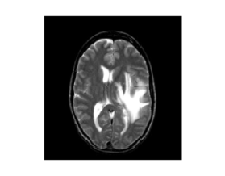
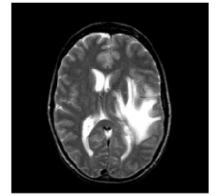
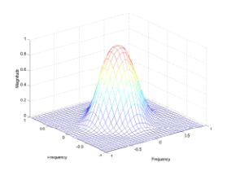

Image Enhancement In Frequency Domain
Original image
Filtered image
Dr A S Jalal
Notes:
The use of frequency methods in image processing is well established. It owes its existence partly to the regular use of this approach in electrical engineering and electronic signal processing; many of the benefits that have accrued in these activities have also extended to 2D imaging (as well as 3D and other forms). There are a number of operations in measurement and processing of images that can be performed with great convenience in the frequency domain, but can only be achieved in the (more familiar) spatial domain with significantly greater computational effort.
In some cases frequency methods receive less attention than they possibly deserve, perhaps because their notation is regarded by many as intimidating and the underlying theory is somewhat mathematical.
Frequency methods are applied in imaging work for several different reasons. In some cases these lead to methods of image compression, in which the amount of data used to represent the image can be reduced without objectionable loss in fidelity. Frequency methods lead to an elegant method for performing spatial filtering as an alternative to the spatial convolution approach (already encountered as low-pass and high-pass filter masks). They are also widely used in reconstruction of 2D and 3D images from 1D and 2D ‘slices’, in the procedure known as tomography.

Slide 2
Frequency Domain
FREQUENCY refers to the RATE OF REPETITION of some periodic event.
In imaging, SPATIAL FREQUENCY is the rate at which the brightness of an image changes with position in space.
High spatial frequencies correspond to rapidly varying, fine detail; low spatial frequencies correspond to slowly changing brightness.
Theory shows that any varying signal (1D or 2D) can be decomposed or TRANSFORMED into a series of simple periodic variations.
The Fourier Transform is one of the best known techniques for performing such a decomposition, and decomposes the signal into a set of sine waves of different frequencies.

Slide 3
Frequency Domain Filtering
Steps of filtering in the frequency domain
Calculate the DFT of the image f
Generate a frequency domain filter H
H and F should have the same size
H should NOT be centered. Centered H is for displaying purpose only.
If H is centered, F needs to be centered too and some post-processing is required
Multiply F by H (element by element)
Compute IDFT
Take the real part of the IDFT
Notes:
Frequency methods: the Fourier Transform
FREQUENCY refers to the RATE OF REPETITION of some periodic event. In imaging, SPATIAL FREQUENCY is the rate at which the brightness of an image changes with position in space. High spatial frequencies correspond to rapidly varying, fine detail; low spatial frequencies correspond to slowly changing brightness.
Theory shows that any varying signal (1D or 2D) can be decomposed or TRANSFORMED into a series of simple periodic variations. The Fourier Transform is one of the best known techniques for performing such a decomposition, and decomposes the signal into a set of sine waves of different frequencies.

Slide 4
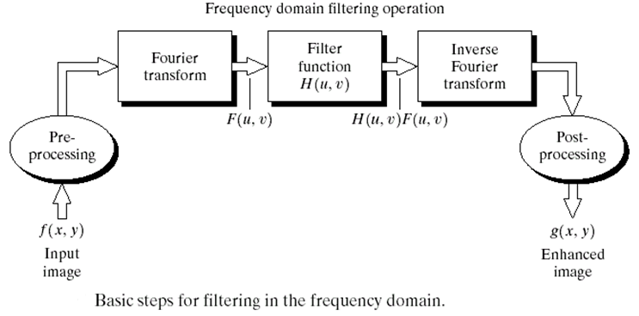
Frequency Domain Filtering

Slide 5
Correspondence between Filtering in the Spatial and Frequency Domains
Filter in the Spatial Domain can be expressed by the convolution function.
g(x,y)=h(x,y)⊗f(x,y)
Convolution in Time Domain
G(u,v)=F(u,v)⋅H(u,v)
Multiplication in Frequency Domain
Filtering in Frequency Domain with H(u,v) is equivalent to filtering in Spatial Domain with f(x,y).

Slide 6
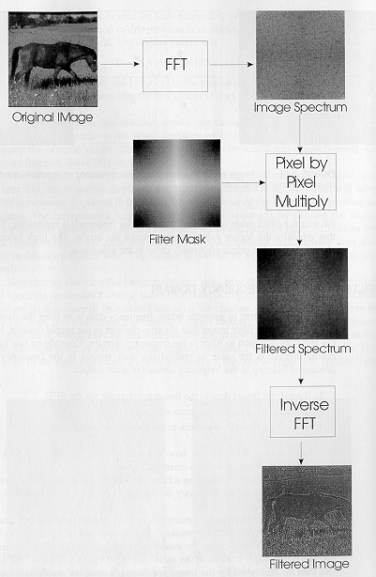
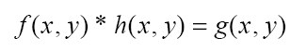

Slide 7
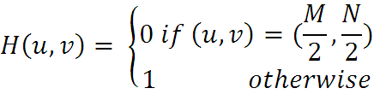
Some Basic Filters
Notch Filter
Forces the average value of an image to zero
Average value of an image given by F(0, 0)
Set F(0, 0) to zero in the Frequency domain
Take the inverse transform
If the transform has been centred, the average value can be forced to zero by the following filter function:

Slide 8
Notch Filter
Using a filter H(u,v) that is 0 at the center of the transform and 1 elsewhere,
what’s the output image?
Notes:
Notch filter are used to remove repetitive "Spectral" noise from an image. are like a narrow highpass filter, but they "notch" out frequencies other than the dc component.

Slide 9
Some Basic Filters
Lowpass Filter: Lowpass filtered image have less sharp details than the original image
Attenuates high frequencies
Passes low frequencies
Highpass Filter: Highpass filtered image have less gray level variations in the smooth areas & emphasized transitional (e.g. edge) gray level details. Such an image appears sharper.
Attenuates low frequencies
Passes high frequencies

Slide 10
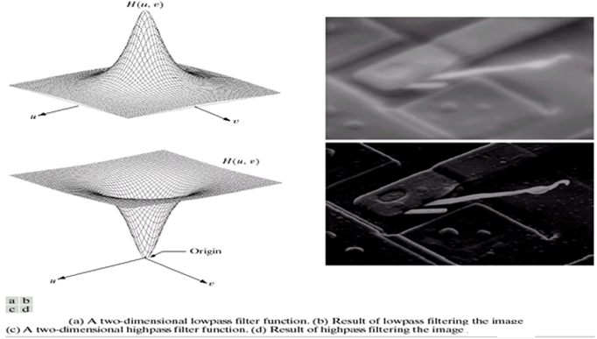
Lowpass Filter & Highpass Filter

Slide 11
Smoothing Frequency Domain Filters
Smoothing (blurring) is achieved in the frequency domain by attenuating a specified range of high frequency components in the transform of a given image

Slide 12
Lowpass Filtering
3 types of filters in the order of increasing smoothness
Ideal filter
Very sharp
Butterworth filter
For high values of “filter order” the Butterworth filter approaches the form of the ideal filter
For lower-order values, the Butterworth filter has a smooth form similar to the Gaussian filter
Gaussian filter
Very smooth

Slide 13
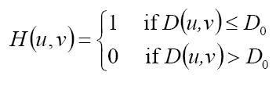
Ideal Lowpass filters (ILPF)
Cuts – off all high frequency components of the Fourier transform which are at a distance greater than a specified distance D₀ from the origin of the (centred) transform
(M/2,N/2): center in frequency domain
D₀ is called the cutoff frequency.

Slide 14
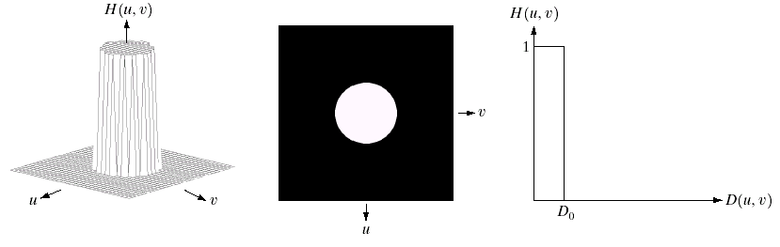
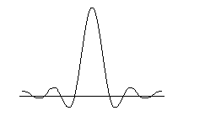
Cutoff frequency
cutoff frequency
Frequency domain
h(x,y)
Spatial domain

Slide 15
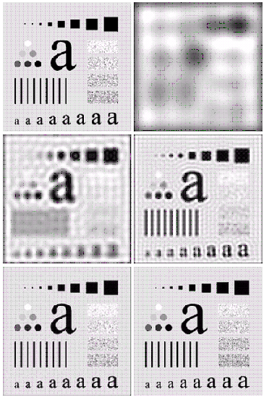
Ideal Lowpass filters (ILPF): Example
When the cut off frequency loci is small, all details are lost due to blurring. Large objects appear as blobs.
As the filter radius increases, blurring becomes less severe.
A “ringing” effect becomes finer in texture as the amount of high frequency content removed decreases. The “ringing” effect is a characteristic of ideal filters.
Original
D=5
D=15
D=30
D=80
D=230

Slide 16
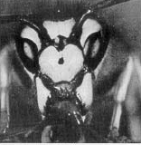
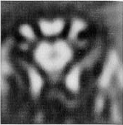
Ideal Lowpass filters (ILPF): Example
Typically, frequencies are concentrated around the center of the spectrum.
orig
r=8 (90% power)
r=18 (93% power)
r=43 (95%)
r=78 (99%)
r=152 (99.5%)

Slide 17
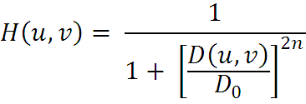
Butterworth Lowpass filters (BLPF)
The transfer function of a BLPF of order n & with a cut off frequency at a distance D₀ from the origin is given as:
The BLPF (unlike ILPF), does not have a sharp discontinuity that establishes a clear cut off between passed & filtered frequencies.
A BLPF of order 1 has no ringing. Ringing generally is imperceptible in filters of order of 2, but can become a significant factor in filters of higher order.

Slide 18
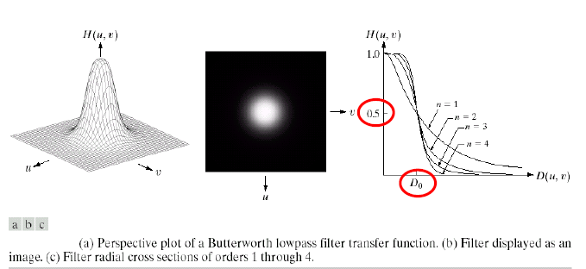
Butterworth Lowpass filters (BLPF)

Slide 19
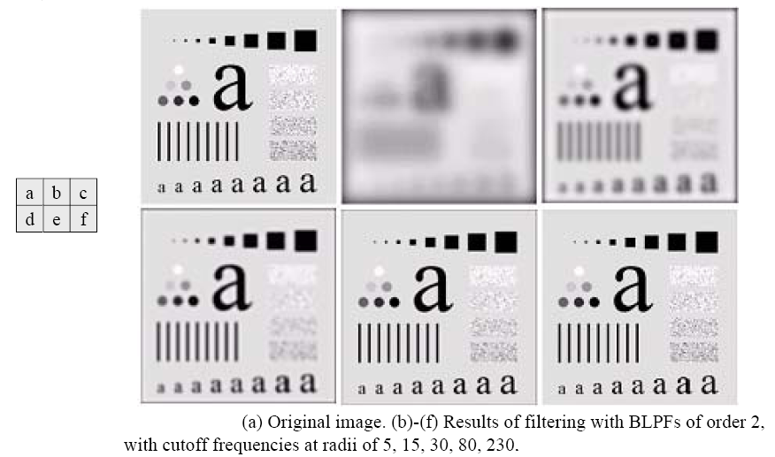
Butterworth Lowpass filters (BLPF)

Slide 20
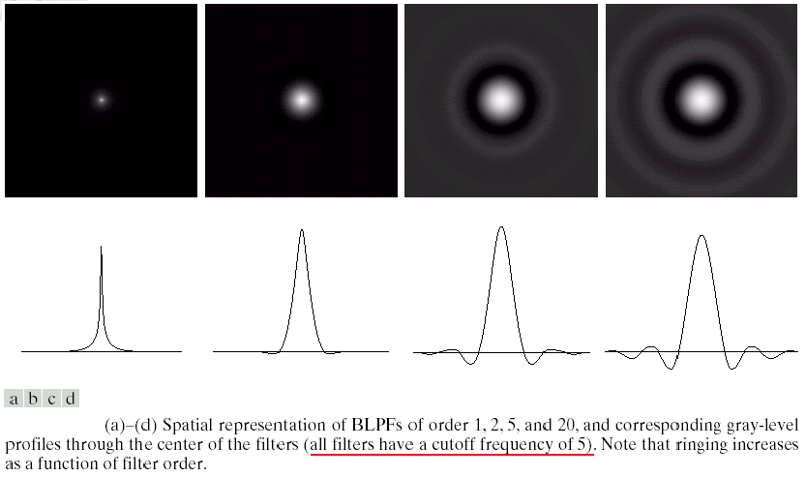
Spatial representation of BLPFs of different orders
No ringing
Filter of order 20 approximates the ringing behavior of ILPF

Slide 21
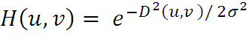
Gaussian Lowpass filters (GLPF)
The form of these filters in 2-D
D(u,v) :the distance from the origin of the Fourier transform
: a measure of the spread of the Gaussian curve

Slide 22
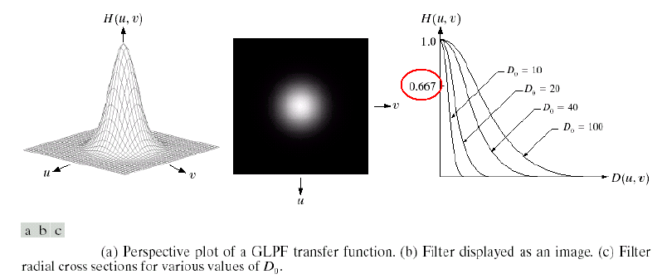
Gaussian Lowpass filters (GLPF)

Slide 23
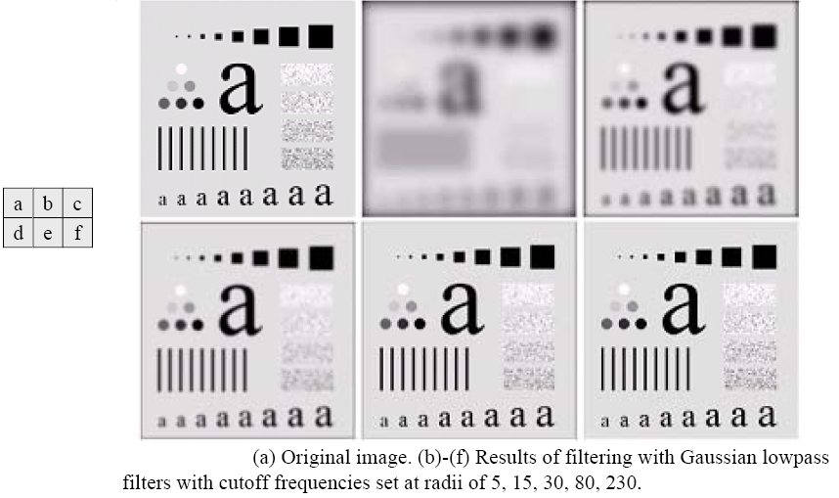
Gaussian Lowpass filters (GLPF): Example
The GLPF did not achieve as much smoothing as the BLPF of order 2 for the same value of cutoff frequency

Slide 24
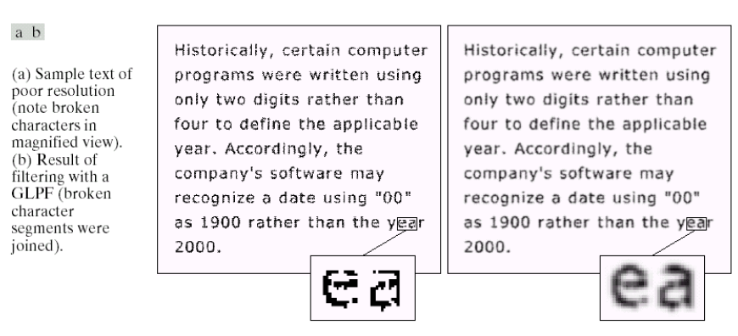
Gaussian Lowpass filters (GLPF): Example
Examples : fax transmissions, duplicated material & historical records
The characters have distorted shapes due to lack of resolution, and many of the characters are broken
Solution: bridge small gaps by blurring
: 80

Slide 25
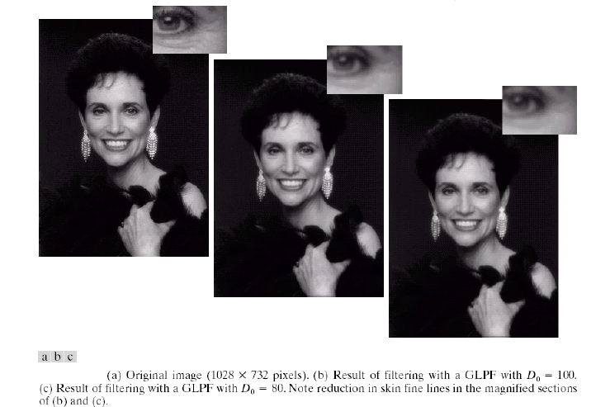
Gaussian Lowpass filters (GLPF): Example
Produce a smoother, softer-looking result from a sharp original
Reduction in skin fine lines in the magnified sections

Slide 26
Sharpening Frequency Domain Filters
Edges & other abrupt changes in gray levels are associated with high frequency components. Image sharpening can be achieved in the frequency domain by a highpass filtering process, which attenuates the low frequency components without disturbing high frequency components in the Fourier transform.

Slide 27
Highpass Filtering
3 types of filters in the order of increasing Sharpening
Ideal filter
Butterworth filter
Gaussian filter
High-pass filter function can be obtained using the relation:

Slide 28
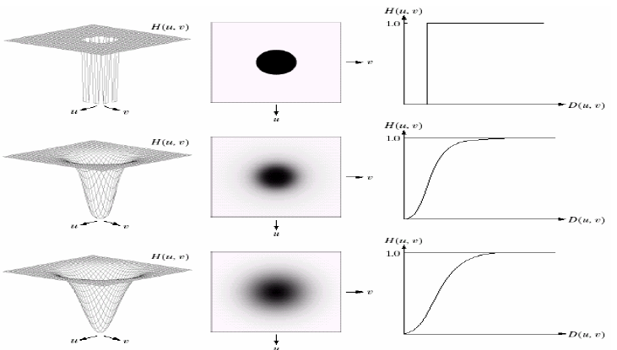
Frequency domain highpass filters
Image representation
Perspective plot
Cross section
Ideal highpass filter
Butterworth highpass filter
Gaussian highpass filter

Slide 29
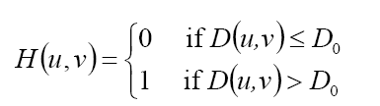
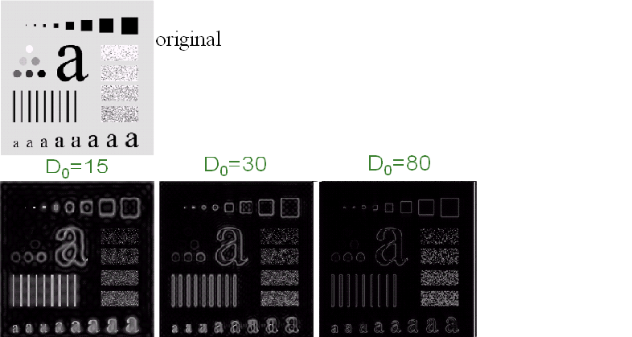
Ideal Highpass filters (IHPF)
Opposite to low-pass filtering: eliminating center and keeping the others

Slide 30
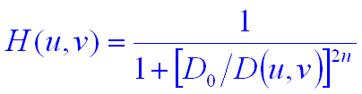
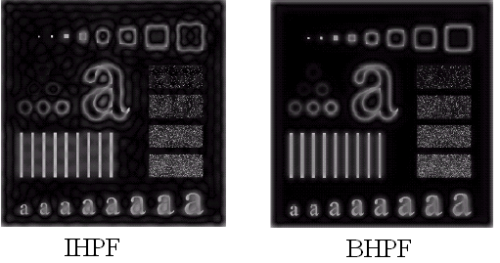
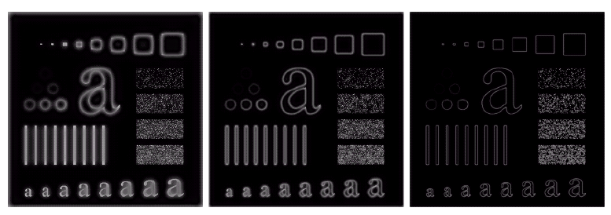
Butterworth Highpass filters (BHPF)
D₀=15
D₀=30
D₀=80
These results are much smoother than those obtained with an IHPF

Slide 31
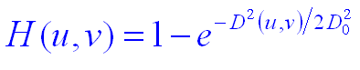
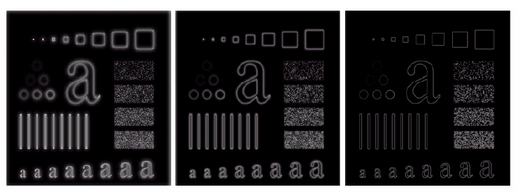
Gaussian Highpass filters (GHPF)
D₀=15
D₀=30
D₀=80

Slide 32
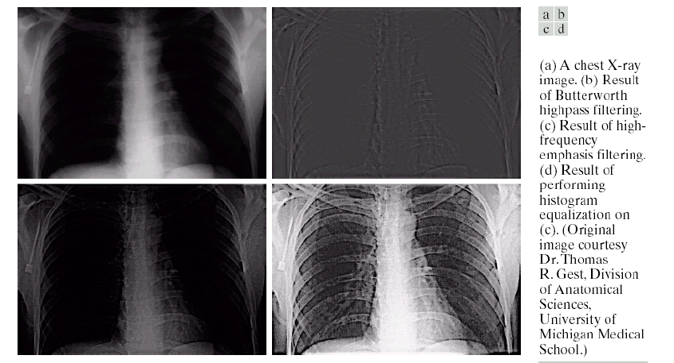
Example
Only the edges are predominant in the image because the low-frequency components were severely attenuated
Amplifies the high-frequency components to values that are higher than in the original transform
Histogram equalization is ideally suited for this purpose because of its ability to increase contrast

Slide 33
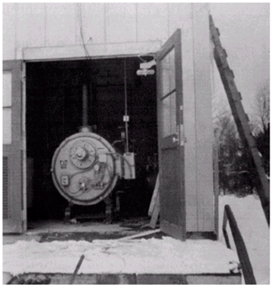
Homomorphic Filtering
Many times, we want to remove shading effects from an image (i.e., due to uneven illumination)
Enhance high frequencies
Attenuate low frequencies but preserve fine detail.

Slide 34
Homomorphic Filtering
Consider the following model of image formation:
i(x,y): illumination
r(x,y): reflection
In general, the illumination component i(x,y) varies slowly and affects low frequencies mostly.
In general, the reflection component r(x,y) varies faster and affects high frequencies mostly.

Slide 35
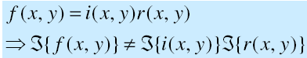
Homomorphic Filtering
A frequency domain procedure for improving the appearance of an image by
Simultaneous gray-level range compression
Contrast enhancement
Express an image as illumination & reflectance components
Characteristic:
illumination component : slow spatial variation (low frequency)
reflectance component : tend to vary abruptly, particular at the junctions of dissimilar objects (high frequency)
Because the Fourier transform of the product of two functions is not separable
Notes:
Homomorphic filter is sometimes used for image enhancement. It simultaneously normalizes the brightness across an image and increases contrast. Here homomorphic filtering is used to remove multiplicative noise. Illumination and reflectance are not separable, but their approximate locations in the frequency domain may be located. Since illumination and reflectance combine multiplicatively, the components are made additive by taking the logarithm of the image intensity, so that these multiplicative components of the image can be separated linearly in the frequency domain. Illumination variations can be thought of as a multiplicative noise, and can be reduced by filtering in the log domain.
To make the illumination of an image more even, the high-frequency components are increased and low-frequency components are decreased, because the high-frequency components are assumed to represent mostly the reflectance in the scene (the amount of light reflected off the object in the scene), whereas the low-frequency components are assumed to represent mostly the illumination in the scene.

Slide 36
Can we separate low from high frequencies?
Low and high frequencies from i(x,y) and r(x,y)
have been mixed together...
Difficult to handle low/high frequencies separately …

Slide 37
Can we separate low from high frequencies?
Idea !
Take the ln( ) of

Slide 38
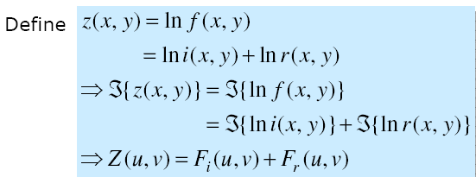
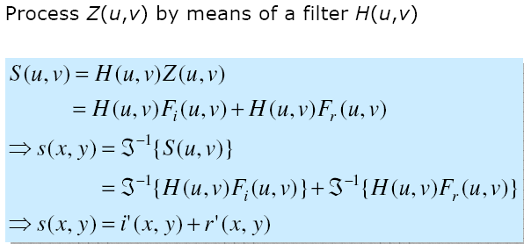
Homomorphic Filtering …

Slide 39
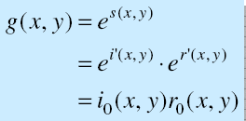
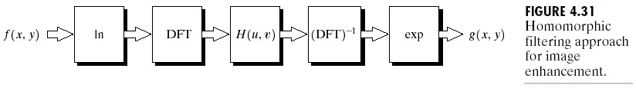
Homomorphic Filtering …
The enhanced image g(x, y)
Homomorphic filtering approach for image enhancement

Slide 40
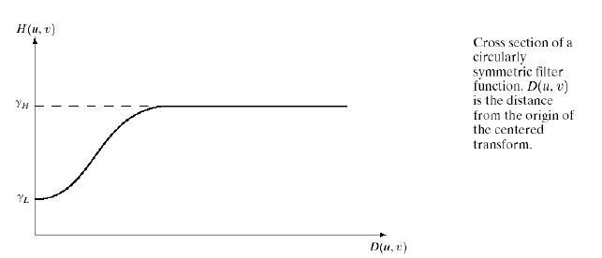
Homomorphic Filtering …
A good deal of control can be gained over the illumination & reflectance components with a homomorphic filter
Treat the low & high frequency components in different ways
If the parameters and are chosen so that < 1 and > 1, the filter function tends to decrease the low frequencies and amplify the high frequencies

Slide 41
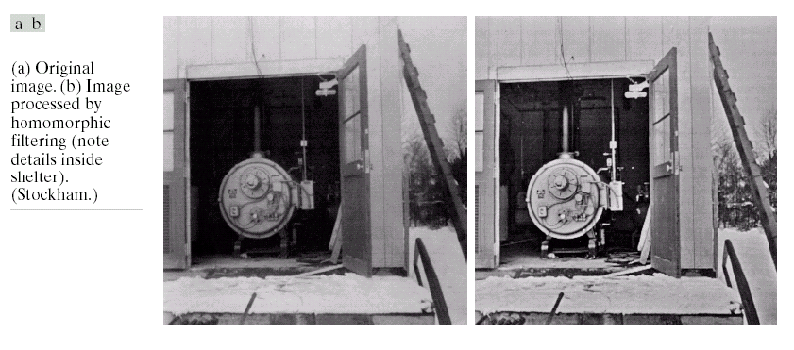
Homomorphic Filtering: Example
The result of processing this image by homomorphic filtering is with =0.5 and =2.0 in the above filter function
A reduction of dynamic range in the brightness, together with an increase in contrast, brought out the details of objects inside the room and balanced the gray levels of the outside wall

Slide 42

Any Questions ?

